Slide 1

CC 141 Discrete Structures Department of Computer Science School of Systems and Technology University of Management and Technology Lahore, Pakistan

Slide 2
Section 1.6 Argument & Rules of Inference

Slide 3
Motivation
Proofs in mathematics are valid arguments that establish the truth of mathematical statements.
Mathematical proofs are necessary in CS
You must always (try to) prove that your algorithm
terminates
is complete, optimal
You may also want to show that it is more efficient than another method
Proving certain properties may lead to new, more efficient or simpler algorithms
Notes:
Google Ads
Video recommendation

Slide 4
Logic:
Logic rules and principles is to distinguish an argument is valid or invalid.
Examples of Arguments:
You have a intuitive idea about argument. When you are talking with you friend you give argument.
Sometimes you say to your friend “what are you saying has no logic” it means you are saying that your argument is not valid.
Lawyer in court during the trail to defend client, give argument. Judge decision is also based on lawyer argument if its argument is valid then decision will be in his favor.

Slide 5
Argument
An argument in propositional logic is a sequence of propositions that end with a conclusion.
All the propositions in the argument are called premises and the final proposition is called the conclusion.
P₁ Premise
P₂ Premise
P₃ Premise
. . . . .. . . . .
P_{n} Premise
______________
∴C Conclusion
NOTE : The symbol ∴ read “therefore,” is normally placed just before the conclusion.

Slide 6
Example:
An interesting teacher keeps me awake.
I stay awake in discrete structure class.
Therefore, my discrete structure teacher is interesting.
1st two statements we are declaring(premises) on this basis 3rd line is giving conclusion.
The argument presenting is, its valid or not?

Slide 7
Validity of an Argument
An argument is valid if the conclusion is true when all the premises are true.
Alternatively, an argument is valid if conjunction of its premises imply conclusion.
That is (P₁∧ P₂ ∧ P₃ ∧ . . . ∧ P_{n}) → C is a tautology.
In that case if argument becomes tautology then we say the argument is valid.

Slide 8
p implies q is mostly true.
p implies q is false whenever
p is true and q is false
That is
P true, q false then p → q is false

Slide 9
Note:
In argument, if one premise is false then we say argument is valid. Because premise implies conclusion, the premise is false implies conclusion is whatever the implication of argument becomes true.
If all the premise is true then the conjunction of all the premise is also true. And if the conclusion becomes also true, then the whole implication becomes true.
Therefore = thus = so that

Slide 10
Invalidity of an Argument
An argument is invalid if the conclusion is false when all the premises are true.
Alternatively, an argument is invalid if conjunction of its premises does not imply conclusion.
Validity of argument:
When our premises conjunction is false, the argument is valid no matter what is the value of conclusion
When our premises conjunction is true and conclusion is false, only then argument is invalid.

Slide 11
Argument Form
If the premises and the conclusion
are statement forms
instead of statements,
then the resulting form is called
argument form.
Ex: If p then q;
p;
q.

Slide 12
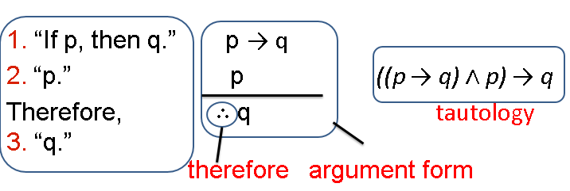
Argument Form
1. “If you have the current password, then you can log onto the network.”
p q
2. “You have a current password.”
Therefore,
3. “You can log onto the network.”

Slide 13
Checking the validity of an argument form
Construct truth table for the premises and the conclusion;
Find the rows in which all the premises are true (critical rows);
a. If in each critical row the conclusion
is true
then the argument form is valid;
b. If there is a row in which conclusion is false
then the argument form is invalid.

Slide 14
EXAMPLE:
Show that the following argument form is valid:
p → q premise
p premise
q conclusion

Slide 15
premises
conclusion
p | q | p → q | p | q
T | T | T | T | T
T | F | F | T | F
F | T | T | F | T
F | F | T | F | F
critical row
To validity we will not analyze the whole table.
We will analyze those rows where in premise we have T
value, and if corresponding conclusion also have T value,
then we say it’s a valid argument.

Slide 16
EXAMPLE OF INVALID ARGUMENT
Show that the following argument form is invalid:
p → q premise
q premise
p conclusion

Slide 17
premises
conclusion
p | q | p → q | q | p
T | T | T | T | T
T | F | F | F | T
F | T | T | T | F
F | F | T | F | F
critical row
This argument is not valid.

Slide 18
EXERCISE
Use truth table to determine the argument form
p ∨ q premise
p → ~q premise
p → r premise
r conclusion
Is valid or invalid?

Slide 19
p ∨ q premise
p → ~q premise
p → r premise
r conclusion
Is valid or invalid?
p | q | r | p ∨ q | p →~q | p → r | r
T | T | T | T | F | T | T
T | T | F | T | F | F | F
T | F | T | T | T | T | T
T | F | F | T | T | F | F
F | T | T | T | T | T | T
F | T | F | T | T | T | F
F | F | T | F | T | T | T
F | F | F | F | T | T | F

Slide 20
premises
conclusion
p | q | r | p ∨ q | p →~q | p → r | r
T | T | T | T | F | T | T
T | T | F | T | F | F | F
T | F | T | T | T | T | T
T | F | F | T | T | F | F
F | T | T | T | T | T | T
F | T | F | T | T | T | F
F | F | T | F | T | T | T
F | F | F | F | T | T | F
critical rows
The argument is not valid because all corresponding values in conclusion are not T

Slide 21
WORD PROBLEM … Do it yourself
If Tariq is not on team A, then Hameed is on team B.
If Hameed is not on team B, then Tariq is on team A.
Tariq is not on team A or Hameed is not on team B.
SOLUTION:
Let
t = Tariq is on team A
h = Hameed is on team B
Then the argument is
~ t → h
~ h → t
∴ ~ t ∨ ~ h

Slide 22
t | h | ~t → h | ~h → t | ~t ∨~h
T | T | T | T | F
T | F | T | T | T
F | T | T | T | T
F | F | F | F | T
Argument is invalid. Because there are three critical rows ( Remember that the critical rows are those rows where the premises have truth value T) and in the first critical row conclusion has truth value F. (Also remember that we say an argument is valid if in all critical rows conclusion has truth value T)

Slide 23
EXERCISE … Do it yourself
If at least one of these two numbers is divisible by 6, then the product of these two numbers is divisible by 6.
Neither of these two numbers is divisible by 6.
The product of these two numbers is not divisible by 6.
SOLUTION:
Let p = at least one of these two numbers is divisible by 6.
q =product of these two numbers is divisible by 6.
Then the argument become in these symbols
p → q
~ p
∴ ~ q

Slide 24
We will made the truth table for premises and conclusion as given below:
The Argument is invalid.
p | q | p → q | ~p | ~q
T | T | T | F | F
T | F | F | F | T
F | T | T | T | F
F | F | T | T | T

Slide 25
EXERCISE … Do it yourself
If I got an Eid bonus, I’ll buy a stereo.
If I sell my motorcycle, I’ll buy a stereo.
If I get an Eid bonus or I sell my motorcycle, then I’ll buy a stereo.
SOLUTION:
Let
e = I got an Eid bonus
s = I’ll buy a stereo
m = I sell my motorcycle

Slide 26
The argument is
e → s
m → s
∴ e ∨ m → s
The argument is valid. Because there are five critical rows
e | s | m | e →s |  | m →s | e ∨ m | e ∨ m →s
T | T | T | T | T |  | T | T
T | T | F | T | T |  | T | T
T | F | T | F | F |  | T | F
T | F | F | F | T |  | T | F
F | T | T | T | T |  | T | T
F | T | F | T | T |  | F | T
F | F | T | T | F |  | T | F
F | F | F | T | T |  | F | T

Slide 27
REMEMBER:
( Remember that the critical rows are those rows where the premises have truth value T) and in all critical row conclusion has truth value T. (Also remember that we say an argument is valid if in all critical rows conclusion has truth value T)

Slide 28
EXERCISE … Do it yourself
An interesting teacher keeps me awake. I stay awake in Discrete Mathematics class. Therefore, my Discrete Mathematics teacher is interesting.
Solution:
t: my teacher is interesting
a: I stay awake
m: I am in Discrete Mathematics class
The argument to be tested is
t → a,
a ∧ m
Therefore m ∧ t

Slide 29
t | a | m | t → a | a ∧ m | m ∧ t
T | T | T | T | T | T
T | T | F | T | F | F
T | F | T | F | F | T
T | F | F | F | F | F
F | T | T | T | T | F
F | T | F | T | F | F
F | F | T | T | F | F
F | F | F | T | F | F
Argument is not valid.

Slide 30
Rules of Inference

Slide 31
RULES OF INFERENCE
We always use a truth table to show that an argument form is valid.
We do this by showing that whenever the premises are true, the conclusion must also be true. This can be a tedious approach.
For Example:
When an argument form involves 10 different propositional variables, to use a truth table to show this argument form is valid requires 2¹º = 1024 rows.

Slide 32
RULES OF INFERENCE
Inference rules are templates for valid arguments.
These rules of inference can be used as building blocks to construct more complicated valid argument forms.
There are different kind of rules of inference:
Modus Ponens
Modus Tollens
Hypothetical Syllogism
Disjunctive Syllogism
Addition
Simplification
Conjunction
Resolution

Slide 33
Valid Arguments in Propositional Logic
is a tautology (always true)
This is another way of saying that

Slide 34
Rules of Inference for Propositional Logic
The 1st law
modus ponens
aka
law of detachment
modus ponens (Latin) translates to “mode that affirms”

Slide 35
MODUS PONENS
p
p → q
q
Alternatively, ((p ∧ (p → q))→q) is Tautology.
Modus Ponens tells us that is a conditional statement and hypothesis of this conditional statement are both true, then the conclusion must also be true.

Slide 36
EXAMPLE
If you have a current password, then you can log on to the network.
You have the password.
Therefore,
You can log on to the network.
Solution:
Let p = you have a current password.
q = you can log on to the network
Symbolically:
p → q
p
q
(this form of argument is called modus ponens)

Slide 37
MODUS TOLLENS
~ q
p → q
~ p
Alternatively, ((~ q ∧ (p → q))→ ~ p) is Tautology.
Modus Tollens tells us that a conditional statement is true, conclusion of this conditional statement is false, then the hypothesis will also be false.

Slide 38
EXAMPLE
You can’t log on to the network.
If you have a current password, then you can log on to the network.
Therefore,
You don't have a current password.
Solution:
Let p = you have a current password.
q = you can log on to the network
Symbolically:
~ q
p → q
~ p

Slide 39
The rules of inference

Slide 40
Exercise:
State which rule of inference is the basis of the following argument:
“It is below freezing now. Therefore, It is either below freezing or raining now.”
Solution:
Let p = It is below freezing.
q = It is raining now.
Symbolically,
p
p ∨ q
This is an argument that uses Addition rule of inference.

Slide 41
Exercise:
State which rule of inference is the basis of the following argument:
“It is below freezing and raining now. Therefore, it is below freezing now.”
Solution:
Let p = It is below freezing.
q = It is raining now.
Symbolically,
p ∧ q
p
This argument uses simplification rule of inference.

Slide 42
Exercise:
State which rule of inference is the basis of the following argument:
“If it rains today, then we will not have a barbecue today. If we do not have a barbecue today, then we will have a barbecue tomorrow. Therefore, if it rains today, then we will have a barbecue tomorrow.”
Solution:
Let p = If it rains today.
q = we will not have a barbecue today.
r = we will have a barbecue tomorrow.

Slide 43
Symbolically,
p → q
q → r
p → r
Hence, the argument is hypothetical syllogism.

Slide 44
Valid Arguments in Propositional Logic
Is this a valid argument?
If you listen you will hear what I’m saying
You are listening
Therefore, you hear what I am saying
Let p represent the statement “you listen”
Let q represent the statement “you hear what I am saying”
The argument has the form:

Slide 45
USING RULES OF INFERENCE TO BUILD ARGUMENTS
When there are many premises, several rules of inference are often needed to show that an argument is valid.
You translate the statement into argument form using propositional variables.
You then want to get from premises/hypothesis(A) to the conclusion (B) using rules of inference.

Slide 46
EXAMPLE
“It is not sunny this afternoon and it is colder then yesterday.” “We will go swimming only if it is sunny.” “If we do not go to swimming, then we will take a canoe trip,” and “if we take a canoe trip, then we will be home by sunset” lead to the conclusion “we will be home by sunset.”
Solution:
Let p = It is sunny this afternoon.
q = It is colder then yesterday.
r = We will go to swimming.
s = We will take a canoe trip.
t = We will be home by sunset.

Slide 47
Symbolically,
Premises
Conclusion

Slide 48
We construct an argument that our premise
lead to desired conclusion as follows:
~ p ∧ q Premise
~ p Simplification
r → p Premise
~ r Modus Tollens
~ r → s Premise
s Modus Ponens
s → t Premise
t Modus Ponens

Slide 49
EXAMPLE
“If you send me an e-mail message, then I will finish writing the problem,” “If you do not send me an e-mail message, then I will go to sleep early,” and “If I go to sleep early, then I will wake up feeling refreshed.” lead to the conclusion “If I do not finish writing the problem, then I will wake up feeling refreshed.”
Solution:
Let p = You send me an e-mail message.
q = I will finish writing the problem.
r = I will go to sleep early.
s = I will wake up feeling refreshed.

Slide 50
Symbolically,
p → q
~ p → r
r → s
The desired conclusion is:
~ q → s

Slide 51
We construct argument that our premise lead to desired conclusion as follow:
p → q Premise
~ q → ~ p Contrapositive
~ p → r Premise
~ q → r Hypothetical Syllogism
r → s Premise
~ q → s Hypothetical Syllogism

Slide 52
RESOLUTION
The Resolution law is:
Alternatively, ((p ∨ q) ∧ ( ~p ∨ r))→ (q ∨ r) is Tautology.

Slide 53
Example:
Using the resolution rule to show that the hypothesis:
“Jasmine is skiing or it is not snowing” and “It is snowing or Bart is playing hockey” imply that “Jasmine is skiing or Bart is playing hockey.”
Solution:
Let p = It is snowing.
q = Jasmine is skiing.
r = Bart is playing hockey.

Slide 54
Symbolically,
~ p ∨ q
p ∨ r
q ∨ r
Using Resolution the q ∨ r follows.

Slide 55
EXAMPLE … Do it yourself
In the back of an old cupboard you discover a note signed by a pirate famous for his sense of humor and love of logical puzzles. In the note he wrote that he had hidden treasure somewhere on the property. He listed five true statements (a–d below) and challenged the reader to use them to figure out the location of the treasure using inference rules for propositional logic
If this house is next to a lake, then the treasure is not in the kitchen.
This house is next to a lake.
If the tree in the front yard is an elm, then the treasure is in the kitchen.
The tree in the front yard is an elm or the treasure is buried under the flagpole.
Where is the treasure hidden?

Slide 56
Practice Questions
Do it by Yourself

Slide 57
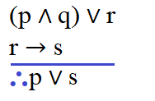
Laws of Inference … Example
Prove that the following argument is valid:

Slide 58
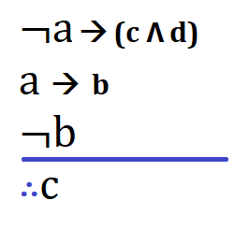
Laws of Inference … Example
Prove that the following argument is valid:

Slide 59
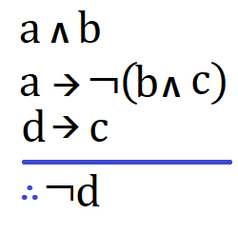
Laws of Inference … Example
Prove that the following argument is valid:

Slide 60
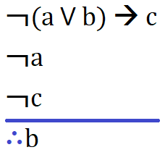
Laws of Inference … Example
Prove that the following argument is valid:

Slide 61
Laws of Inference … Exercises
Prove that the following argument is valid:
If Ali is disciplined, his job is in forces.
Ali is disciplined
---------------------------------------------------
∴Ali’s job is in forces.

Slide 62
Laws of Inference … Exercises
Prove that the following argument is valid:
If sun is shining, I will go out for a walk.
Sun is shining.
---------------------------------------------------
∴I will go out for a walk.

Slide 63
Laws of Inference … Exercises
Prove that the following argument is valid:
If the teacher is absent, he must be sick.
The teacher is not absent.
---------------------------------------------------
∴The teacher must not be sick.

Slide 64
Laws of Inference … Exercises
Prove that the following argument is valid:
If my attendance is short, I will fail this course.
My attendance is not short.
---------------------------------------------------
∴I should not fail this course.

Slide 65
Laws of Inference … Exercises
Prove that the following argument is valid:
If accountability is better in system, the culprit will be punished.
If the culprit is punished, crime rate in city remains in control.
---------------------------------------------------
∴If the accountability is better in system, crime rate in city remains in control.

Slide 66
Laws of Inference … Exercises
Prove that the following argument is valid:
If the technical education is adequate, industry gets suitable work force.
If industry gets suitable workforce, unemployment is reduced in country.
---------------------------------------------------
∴ If the technical education is adequate, unemployment is reduced in country.

Slide 67
Laws of Inference … Exercises
Prove that the following argument is valid:
If we eat fresh vegetables, our immunity is improved.
If our immunity is improved, we are less prone to seasonal diseases.
---------------------------------------------------
∴ If we eat fresh vegetables, we are less prone to seasonal diseases.

Slide 68
Laws of Inference … Exercises
Prove that the following argument is valid:
I will stay at home or I will go to the office.
I will not stay at home.
---------------------------------------------------
∴ I will go to the office.

Slide 69
Laws of Inference … Exercises
Prove that the following argument is valid:
I will take tea or I will take fresh lime.
I will not take tea.
---------------------------------------------------
∴ I will take fresh lime.

Slide 70
Laws of Inference … Exercises
Prove that the following argument is valid:
I will wash my bike on Sunday.
---------------------------------------------------
∴ I will wash my bike on Saturday or on Sunday.

Slide 71
Laws of Inference … Exercises
Prove that the following argument is valid:
You are my crush.
---------------------------------------------------
∴ Either you are my crush or I am going to crush you.

Slide 72
Laws of Inference … Exercises
Prove that the following argument is valid:
Bilal is a vegetarian.
---------------------------------------------------
∴ Bilal is vegetarian or he eats meat occasionally.

Slide 73
Laws of Inference … Exercises
Prove that the following argument is valid:
Umer is lazy or Faisal is quick.
Umer is not lazy or Fatima is smart.
---------------------------------------------------
∴ Faisal is quick or Fatima is smart.

Slide 74
Laws of Inference … Exercises
Prove that the following argument is valid:
James is an innovator or Hamza is an expert programmer.
James is not an innovator or Faria is a content writer.
---------------------------------------------------
∴ Hamza is an expert programmer or Faria is a content writer.

Slide 75
Validity of Arguments … Exercises
Check whether or not the following argument valid:
If it rains, Salman will miss the class.
Salman didn’t miss the class.
---------------------------------------------------
∴ It didn’t rain.

Slide 76
Validity of Arguments … Exercises
Check whether or not the following argument valid:
If Rizwan starts the innings, he will score a hundred.
Rizwan didn’t score a hundred.
---------------------------------------------------
∴ Rizwan didn’t start the innings.

Slide 77
Validity of Arguments … Exercises
Check whether or not the following argument valid:
Lilly is a woman.
Lilly is a gymnast.
---------------------------------------------------
∴ All women are gymnasts.

Slide 78
Validity of Arguments … Exercises
Check whether or not the following argument valid:
All lions are fierce.
Some lions do not drink coffee.
---------------------------------------------------
∴ Some fierce creatures do not drink coffee.

Slide 79
Validity of Arguments … Exercises
Check whether or not the following argument valid:
All lions are fierce.
Some lions do not drink coffee.
---------------------------------------------------
∴ Some fierce creatures do not drink coffee.

Slide 80
Validity of Arguments … Exercises
Check whether or not the following argument valid:
All engineers are educated.
Some engineers cannot draw good pictures.
---------------------------------------------------
∴ Some educated people cannot draw good pictures.

Slide 81
Few More Exercises – Do it by yourself
Five friends A, H, K, R and V have access to an online chat room. We know the following are True:
Either K or H or both are chatting.
Either R or V but not both are chatting
If A is chatting, then R is chatting too.
V is chatting if and only if K is chatting
If H is chatting, both A and K is chatting
Determine who is chatting?

Slide 82
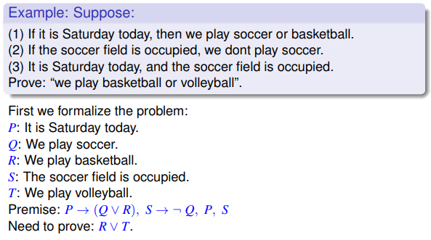
Few More Exercises – Do it by yourself

Slide 83
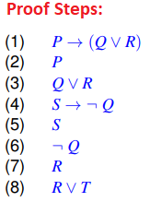
Few More Exercises – Do it by yourself

Slide 84
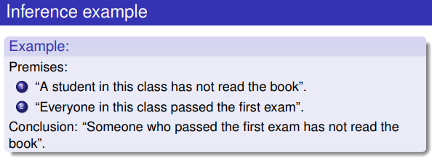
Few More Exercises – Do it by yourself

Slide 85
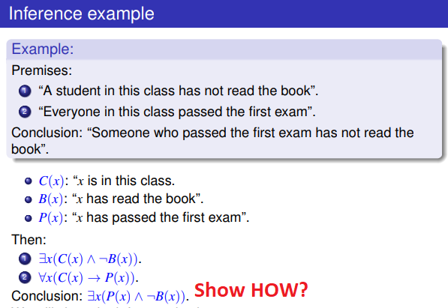
Few More Exercises – Do it by yourself

Slide 86
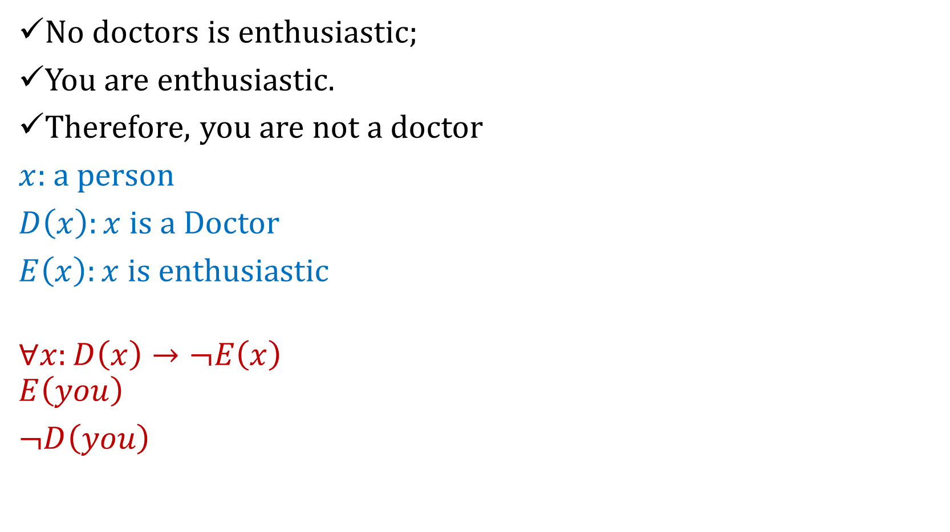
No doctors is enthusiastic;
You are enthusiastic.
Therefore, you are not a doctor
$x:$a person
$D\left(x\right):x$ is a Doctor
$E\left(x\right):x$ is enthusiastic
$$∀x:D\left(x\right)→¬E\left(x\right)$$
$$E\left(you\right)$$
$¬D\left(you\right)$

Slide 87

Summary
The topics we covered:
Arguments
Valid or Invalid Argument
Checking validity of argument using truth table
Rules of inference.
Building arguments using rules of inference
Practice Questions

